Slide 1

SOFTWARE ENGINEERING
UNIT III - SOFTWARE DESIGN
Prof. Rahul Pawar
Assistant Professor,
School of CS&IT,
MCA Department,
Knowledge Campus Jayanagar

Slide 2
Design Diagrams: UML
Unit : III
Unified Modeling Language
UML is a way of visualizing a software program using a collection of diagrams.
UML is accepted by the Object Management Group (OMG) as the standard for modeling software development.
Types of UML Diagrams
Structural diagrams and behavioral or interaction diagrams.

Slide 3
Unit : III
Structural UML diagrams
Class diagram
Package diagram
Object diagram
Component diagram
Composite structure diagram
Deployment diagram
Behavioral UML diagrams
Activity diagram
Sequence diagram
Use case diagram
State diagram
Communication diagram
Interaction diagram
Timing diagram

Slide 4
Use Case Diagrams
Unit : III
Scenario - a specific sequence of actions and interactions between actors and the system
Use case - a collection of related success and failure scenarios, describing actors using the system to support a goal.
Actors - something with a behavior or role, e.g., a person, another system, organization.

Slide 5
Purposes of use case diagrams
Unit : III
Used to gather the requirements of a system.
Used to get an outside view of a system.
Identify the external and internal factors influencing the system.
How to Draw a Use Case Diagram?
Show the interaction among the requirements.
Actors can be a human user, some internal applications, or may be some external applications. To draw a use case diagram, the following items should be identified.
Functionalities to be represented as use case
Actors
Relationships among the use cases and actors.

Slide 6
Guidelines to be followed to draw an efficient use case diagram
Unit : III
Use case diagrams are drawn to capture the functional requirements of a system.
The name of a use case is very important. The name should be chosen in such a way so that it can identify the functionalities performed.
Give a suitable name for actors.
Show relationships and dependencies clearly in the diagram.
Do not try to include all types of relationships, as the main purpose of the diagram is to identify the requirements.
Use notes whenever required to clarify some important points.

Slide 7
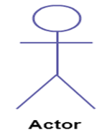
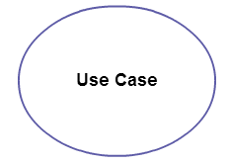
Symbols and Notations
Unit : III
Actor : any entity that performs a role in one given system. This could be a person, organization or an external system and usually drawn like skeleton shown below.
Use Case : represents a function or an action within the system. It’s drawn as an oval and named with the function.

Slide 8
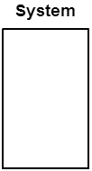
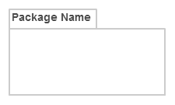
Unit : III
System: The system is used to define the scope of the use case and drawn as a rectangle. This an optional element but useful when you’re visualizing large systems.
Package : The package is another optional element that is extremely useful in complex diagrams. Similar to class diagrams, packages are used to group together use cases. They are drawn like the image shown below.

Slide 9
Unit : III
There can be 5 relationship types in a use case diagram.
Association between actor and use case
Generalization of an actor
Extend between two use cases
Include between two use cases
Generalization of a use case

Slide 10
Relationships
Unit : III
Arrow points to the base use case when using <<extend>>
<<extend>> can have optional extension conditions
Arrow points to the included use case when using <<include>>
Both <<extend>> and <<include>> are shown as dashed arrows.
Actor and use case relationship don’t show arrows.

Slide 11
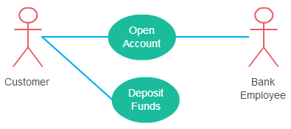
Association Between Actor and Use Case
Unit : III
An actor must be associated with at least one use case.
An actor can be associated with multiple use cases.
Multiple actors can be associated with a single use case.

Slide 12
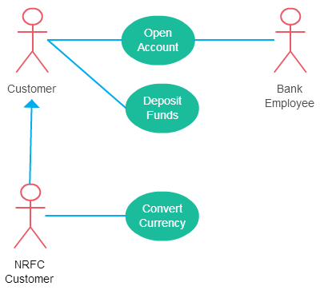
Generalization of an Actor
Unit : III
Generalization -means that one actor can inherit the role of the other actor.
The descendant has one or more use cases that are specific to that role.

Slide 13
Extend Relationship Between Two Use Cases
Unit : III
As the name implies it extends the base use case and adds more functionality to the system.
The extending use case is dependent on the extended (base) use case. In the example diagram the “Calculate Bonus” use case doesn’t make much sense without the “Deposit Funds” use case.
The extending use case is usually optional and can be triggered conditionally. In the diagram, the extending use case is triggered only for deposits over 10,000 or when the age is over 55.
The extended (base) use case must be meaningful on its own. This means it should be independent and must not rely on the behavior of the extending use case.

Slide 14
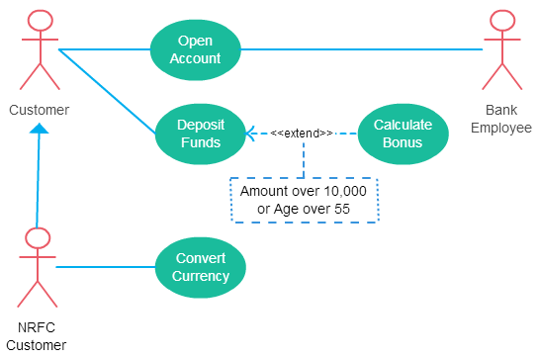
Unit : III

Slide 15
Include Relationship Between Two Use Cases
Unit : III
Shows that the behavior of the included use case is part of the including (base) use case.
The main reason for this is to reuse the common actions across multiple use cases.
In some situations, this is done to simplify complex behaviors.
Few things to consider when using the <<include>> relationship.
The base use case is incomplete without the included use case.
The included use case is mandatory and not optional.

Slide 16
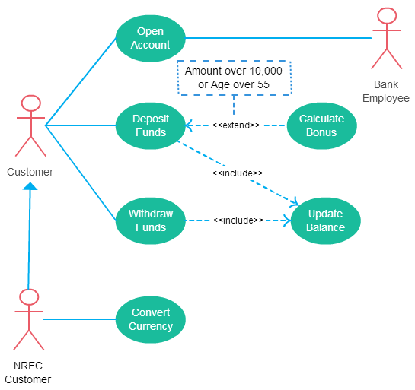
Unit : III

Slide 17
Class Diagrams
Unit : III
A type of static structure diagram that describes the structure of a system by showing the system's classes, their attributes, operations (or methods), and the relationships among objects.
The purpose of the class diagram can be summarized as follows -
Analysis and design of the static view of an application.
Describe responsibilities of a system.
Base for component and deployment diagrams.
To perform Forward and reverse engineering.
Construction of software using object oriented languages

Slide 18
Unit : III
The standard class diagram is composed of three sections:
Upper section: Contains the name of the class. This section is always required
Middle section: Contains the attributes of the class. This is only required when describing a specific instance of a class.
Bottom section: Includes class operations (methods). The operations describe how a class interacts with data.

Slide 19
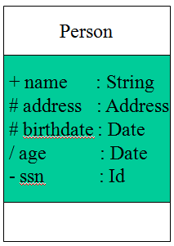
Unit : III
Member access modifiers
All classes have different access levels depending on the access modifier (visibility). Here are the access levels with their corresponding symbols:
Public (+)
Private (-)
Protected (#)
Package (~)
Derived (/)
Static (underlined)

Slide 20
Depicting Classes
Unit : III
When drawing a class, you needn’t show attributes and operation in every diagram.
Person
Person
Person
name : String
birthdate : Date
ssn : Id
Person
name
address
birthdate
eat()
sleep()
work()
play()
Person
eat
play
20

Slide 21
Relationships
Unit : III
In UML, object interconnections (logical or physical), are modeled as relationships.
There are three kinds of relationships in UML:
Dependencies
Generalizations
Associations

Slide 22
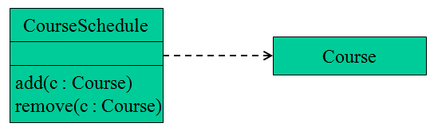
Dependency Relationships
Unit : III
Indicates a semantic relationship between two or more elements.
The dependency from CourseSchedule to Course exists because Course is used in both the add and remove operations of CourseSchedule.

Slide 23
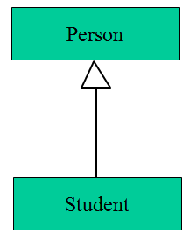
Generalization Relationships
Unit : III
It connects a subclass to its superclass. It denotes an inheritance of attributes and behavior
From the superclass to the subclass and indicates a specialization in the subclass of the more general superclass.

Slide 24
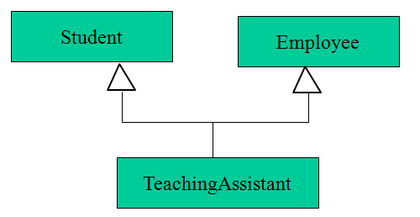
Unit : III
UML permits a class to inherit from multiple super classes, although some programming languages (e.g., Java) do not permit multiple inheritance.

Slide 25
Association Relationships
Unit : III
If two classes in a model need to communicate with each other, there must be link between them.
An association denotes that link.
We can indicate the multiplicity of an association
The example indicates that a Student has one or more Instructors:

Slide 26
Association Relationships (Cont’d)
Unit : III
The example indicates that every Instructor has one or more Students:
Student
Instructor
1..*
indicate the behavior of an object in an association (i.e., the role of an object) using rolenames.
teaches
learns from
Student
Instructor
1..*
1..*
26

Slide 27
Association Relationships (Cont’d)
Unit : III
A class can have a self association.
next
LinkedListNode
previous
27

Slide 28
Association Relationships (Cont’d)
Unit : III
We can model objects that contain other objects by way of special associations called Aggregations And Compositions.
An Aggregation specifies a whole-part relationship between an aggregate (a whole) and a constituent part, where the part can exist independently from the aggregate. Aggregations are denoted by a hollow-diamond on the association.
Car
Engine
Transmission
28

Slide 29
Association Relationships (Cont’d)
Unit : III
A composition indicates a strong ownership and coincident lifetime of parts by the whole (i.e., they live and die as a whole). Compositions are denoted by a filled-diamond adornment on the association.
Window
Scrollbar
1
1
Titlebar
1
1
Menu
1
1 .. *
29

Slide 30
Interfaces
Unit : III
An interface is a named set of operations that specifies the behavior of objects without showing their inner structure. It can be rendered in the model by a one- or two-compartment rectangle, with the stereotype <<interface>> above the interface name.
<<interface>>
ControlPanel
<<interface>>
ControlPanel
Interfaces do not get instantiated. They have no attributes or state. Rather, they specify the services offered by a related class.
getChoices : Choice[]
makeChoice (c : Choice)
getSelection : Selection
30

Slide 31
Interface Realization Relationship
Unit : III
<<interface>>
ControlPanel
A realization relationship connects a class with an interface that supplies its behavioral specification. It is rendered by a dashed line with a hollow triangle towards the specifier.
specifier
implementation
VendingMachine
31

Slide 32
Packages
Unit : III
A package is a container-like element for organizing other elements into groups.
A package can contain classes and other packages and diagrams.
Packages can be used to provide controlled access between classes in different packages.
Compiler
32

Slide 33
Interaction Diagrams
Unit : III
Two Types of Interaction diagrams defined in UML
Sequence Diagram
Emphasizes the time ordering of those messages
Collaboration Diagram
Emphasizes the structural organization of objects that send and receive messages via the method invocation
33

Slide 34
The purpose of interaction diagram is −
Unit : III
To capture the dynamic behavior of a system.
To describe the message flow in the system.
To describe the structural organization of the objects.
To describe the interaction among objects.

Slide 35
Sequence Diagram
Unit : III
A sequence diagram is an interaction diagram that emphasizes the time ordering of messages. It shows a set of objects and the messages sent and received by those objects.
Graphically, a sequence diagram is a table that shows objects arranged along the X axis and messages, ordered in increasing time, along the Y axis.
35

Slide 36
Sequence Diagram
Unit : III
an Order Line
An object in a sequence diagram is rendered
as a box with a dashed line descending from it.
The line is called the object lifeline, and it
represents the existence of an object over a
period of time.
36

Slide 37
Sequence Diagram
Unit : III
Messages are rendered as horizontal arrows being passed from object to object as time advances down the object lifelines. Conditions ( such as [check = “true”] ) indicate when a message gets passed.
an Order Line
a Stock Item
check()
[check = “true”] remove()
Notice that the bottom arrow is different. The arrow head is not solid, and there is no accompanying message.
This arrow indicates a return from a previous message, not a new message.
37

Slide 38
Sequence Diagram
Unit : III
an Order
a Order Line
* prepare()
An iteration marker, such as * (as shown), or *[i = 1..n] , indicates that a message will be repeated as indicated.
Iteration
marker
38

Slide 39
Unit : III
an Order Entry window
an Order
an Order Line
a Stock Item
[Fowler,97]
prepare()
Condition
* prepare()
Object
check()
Message
[check = “true”] remove()
needsToReorder()
Iteration
Return
Self-Delegation
[needsToReorder = “true”]
new
A Reorder Item
[check = “true”] new
A Delivery Item
Creation
39

Slide 40
Collaboration Diagram
Unit : III
It shows the object organization .
In the collaboration diagram, the method call sequence is indicated by some numbering technique.
The number indicates how the methods are called one after another.
To choose between these two diagrams, emphasis is placed on the type of requirement.
If the time sequence is important, then the sequence diagram is used. If object organization is required, then collaboration diagram is used.

Slide 41
Collaboration Diagram Elements
Unit : III
There are three primary elements of a collaboration diagram:
Objects
Links
Messages
41

Slide 42
Unit : III
Collaboration Diagram notations
AN ACTOR
AN OBJECT
AN ASSOCIATION
A MESSAGE
anObject:aClass
aMessage()
42

Slide 43
Objects
Unit : III
Objects­ rectangles containing the object signature
object signature:
object name : object Class
object name (optional) - starts with lowercase letter
class name (mandatory) - starts with uppercase letter
Objects connected by lines and actor can appear
43

Slide 44
Iterating Messages
Unit : III
Collaboration diagrams use syntax similar to sequence diagrams to indicate that either a message iterates (is run multiple times) or is run conditionally
An asterisk (*) indicates that a message runs more than once
Or the number of times a message is repeated can be shown by numbers (for example, 1..5)
44

Slide 45
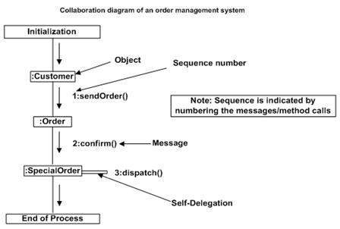
Collaboration diagram for Order Management system
Unit : III

Slide 46
State Chart Diagrams
Unit : III
Describes different states of a component/object in a system.
A Statechart diagram describes a state machine. State machine can be defined as a machine which defines different states of an object and these states are controlled by external or internal events.
Purposes of using Statechart diagrams −
To model the dynamic aspect of a system.
To model the life time of a reactive system.
To describe different states of an object during its life time.
Define a state machine to model the states of an object.

Slide 47
The basic elements of the state chart diagram are as follows:
Unit : III
• Initial state. This is represented as a filled circle.
• Final state. This is represented by a filled circle inside a larger circle.
• State. These are represented by rectangles with rounded corners.
• Transition. A transition is shown as an arrow between two states. Normally, the name of the event which causes the transition is places along side the arrow. A guard to the transition can also be assigned. A guard is a Boolean logic condition. The transition can take place only if the grade evaluates to true. The syntax for the label of the transition is shown in 3 parts: event[guard]/action.

Slide 48
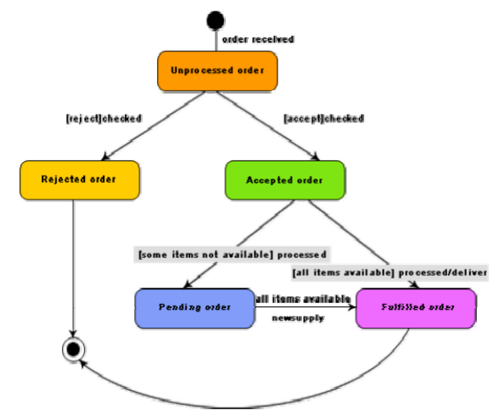
An example state chart for the order object of the Trade House Automation software
Unit : III

Slide 49
Activity Diagrams
Unit : III
Describes how activities are coordinated.
Is particularly useful when you know that an operation has to achieve a number of different things, and you want to model what the essential dependencies between them are, before you decide in what order to do them.
Records the dependencies between activities, such as which things can happen in parallel and what must be finished before something else can start.
Represents the workflow of the process.

Slide 50
Unit : III
Activity arrangement
Sequential – one activity is followed by another
Parallel – two or more sets of activities are performed concurrently, and order is irrelevant
Interleaving is permitted – we can jump between the parallel flows

Slide 51
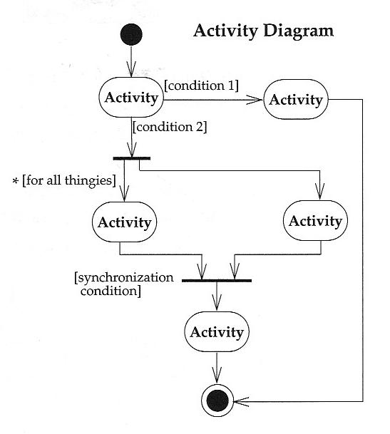
Activity Diagrams - Notation
Unit : III
Start at the top black circle
If condition 1 is TRUE, go right; if condition 2 is TRUE, go down
At first bar (a synchronization bar), break apart to follow 2 parallel paths (Fork)
At second bar, come together to proceed only when both parallel activities are done (Join)

Slide 52
Activity Diagrams – Notation (concluded)
Unit : III
Activity – an oval
Trigger – path exiting an activity
Guard – each trigger has a guard, a logical expression that evaluates to “true” or “false”
Synchronization Bar – can break a trigger into multiple triggers operating in parallel or can join multiple triggers into one when all are complete
Decision Diamond – used to describe nested decisions (the first decision is indicated by an activity with multiple triggers coming out of it)

Slide 53
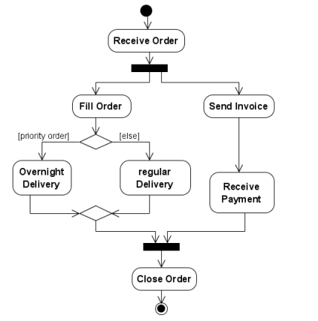
Unit : III

Slide 54
Unit : III
Swimlanes (or activity partitions) indicate where activities take place.
Swimlanes can also be used to identify areas at the technology level where activities are carried out
Swimlanes allow the partition an activity diagram so that parts of it appear in the swimlane relevant to that element in the partition

Slide 55
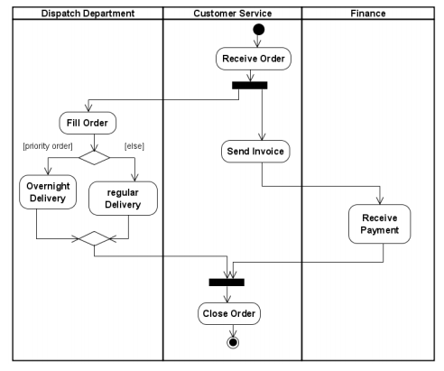
Swimlanes – Example
Unit : III

Slide 56
Sending and Receiving Signals
Unit : III
In activity diagrams, signals represent interactions with external participants
Signals are messages that can be sent or received
A receive signal has the effect of waking up an action in your activity diagram
Send signals are signals sent to external participants.

Slide 57
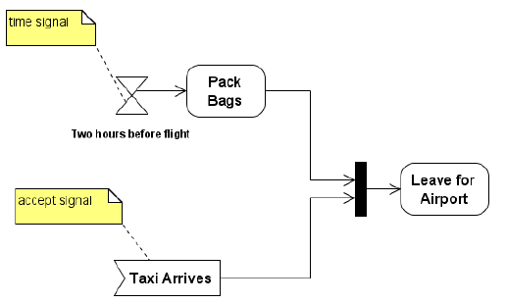
Unit : III

Slide 58
Design Process
Unit : III
Software design is an iterative process through which requirements are translated into a “blueprint” for constructing the software.
Initially, the blueprint depicts a holistic view of software, i.e. the design is represented at a high-level of abstraction.
Throughout the design process, the quality of the evolving design is assessed with a series of formal technique reviews or design walkthroughs.

Slide 59
Software Quality Guidelines and Attributes
Unit : III
Three characteristics serve as a guide for the evaluation of a good design:
The design must implement all of the explicit requirements contained in the analysis model, and it must accommodate all of the implicit requirements desired by the customer.
The design must be a readable, understandable guide for those who generate code and for those who test and subsequently support the software.
The design should provide a complete picture of the software, addressing the data, functional, and behavioral domains from an implementation perspective.

Slide 60
Quality Guidelines
Unit : III
In order to evaluate the quality of a design representation, we must establish technical criteria for good design.
1)A design should exhibit an architecture that:
(a) Has been created using recognizable architectural styles or patterns,
(b) Is composed of components that exhibit good design characteristics,
(c) Can be implemented in an evolutionary fashion
2)A design should be modular; that is, the software should be logically partitioned into elements or subsystems
3) A design should contain distinct representations of data, architecture, interfaces, and components.
4) A design should lead to data structures that are appropriate for the classes to be implemented and are drawn from recognizable data patterns.

Slide 61
Unit : III
5)A design should lead to components that exhibit independent functional characteristics.
6) A design should lead to interfaces that reduce the complexity of connections between components and with the external environment.
7) A design should be derived using a repeatable method that is driven by information obtained during software requirements analysis.
8) A design should be represented using a notation that effectively communicates its meaning.

Slide 62
Quality Attribute
Unit : III
Hewlett-Packard developed a set of software quality attributes that has been given the acronym FURPS. The FURPS quality attributes represent a target for all software design:
Functionality: is assessed by evaluating the features set and capabilities of the program, the generality of the functions that are delivered, and the security of the overall system.
Usability: is assessed by considering human factors, overall visual, consistency, and documentation.
Reliability: is evaluated by measuring the frequency and severity of failure, the accuracy of output results, the mean-time-to-failure, the ability to recover from failure, and the predictability of the program.

Slide 63
Unit : III
Performance: is measured by processing speed, response time, resource consumption, throughput, and efficiency.
Supportability: combines the ability to extend the program extensibility, adaptability, serviceability maintainability. In addition, testability, compatibility, configurability, etc.

Slide 64
Design concepts
Unit : III
What criteria can be used to partition software into individual components?
How is function or data structure detail separated from a conceptual representation of the software?
What uniform criteria define the technical quality of a software design?

Slide 65
Unit : III
1. Abstraction
Highest level of abstraction, a solution is stated in broad terms using the language of the problem environment.
Lower levels of abstraction, a more detailed description of the solution is provided.
As different levels of abstraction are developed- procedural and data abstractions.
A procedural abstraction refers to a sequence of instructions that have a specific and limited function. An example of a procedural abstraction would be the word open for a door.
Open implies a long sequence of procedural steps (e.g., walk to the door, reach out and grasp knob, turn knob and
pull door, step away from moving door, etc.)

Slide 66
Unit : III
A data abstraction is a named collection of data that describes a data object.
In the context of the procedural abstraction open, we can define a data abstraction called door.
Like any data object, the data abstraction for door would encompass a set of attributes that describe the door (e.g., door type, swing direction, opening mechanism, weight, dimensions).

Slide 67
Unit : III
2 Architecture
Software architecture shows “the overall structure of the software and the ways in which that structure provides conceptual integrity for a system”.
Architecture is the structure or organization of program components (modules), the manner in which these components interact, and the structure of data that are used by the components.
The aim of the software design is to obtain an architectural framework of a system.
The more detailed design activities are conducted from the framework.
A set of architectural patterns enable a software engineer to reuse design-level concepts.

Slide 68
Unit : III
3. Patterns
A design pattern describes a design structure and that structure solves a particular design problem in a specified content. The intent of each design pattern is to provide a description that enables a designer to determine:
Whether the pattern is applicable to the current work,
Whether the pattern can be reused, and
Whether the pattern can serve as a guide for developing a similar, but functionally or structurally different pattern.

Slide 69
Unit : III
4 .Separation of Concerns
Separation of concerns is a design concept that suggests that any complex problem can be more easily handled if it is subdivided into pieces that can each be solved and/or optimized independently.
A concern is a feature or behavior that is specified as part of the requirements model for the software.
By separating concerns into smaller, and therefore more manageable pieces, a problem takes less effort and time to solve.

Slide 70
Unit : III
5 Modularity
A software is separately divided into named and addressable components or modules.
Modularity is the single attribute of a software that permits a program to be managed easily.
modularize a design (and the resulting program) so that development can be more easily planned;
software increments can be defined and delivered;
changes can be more easily accommodated;
testing and debugging can be conducted more efficiently,
and long-term maintenance can be conducted without serious side effects.

Slide 71
Unit : III
6. Information Hiding
Modules must be specified and designed so that the information like algorithm and data presented in a module is not accessible for other modules that have no need for such information.
The use of information hiding as a design criterion for modular systems provides the greatest benefits when modifications are required during testing and later during software maintenance.
Because most data and procedural detail are hidden from other parts of the software, inadvertent errors introduced during modification are less likely to propagate to other locations within the software.

Slide 72
Unit : III
7. Functional Independence
is the concept of separation and related to the concept of modularity, abstraction and information hiding.
The functional independence is accessed using two criteria i.e Cohesion and coupling.
Cohesion is an indication of the relative functional strength of a module. A cohesive module performs a single task and it requires a small interaction with the other components in other parts of the program. Strive for high cohesion
Coupling is an indication of the relative interdependence among modules. Always strive for the lowest possible coupling.

Slide 73
Unit : III
8. Refinement
Refinement is a top-down design approach.
It is a process of elaboration.
A program is established for refining levels of procedural details.
A hierarchy is established by decomposing a statement of function in a stepwise manner till the programming language statement are reached.
Refinement helps the designer to reveal low-level details as design progresses.
Refinement causes the designer to elaborate on the original statement, providing more and more detail as each successive refinement “elaboration” occurs.

Slide 74
Unit : III
9. Refactoring
It is a reorganization technique that simplifies the design of a component without changing its function or behavior.
When software is re-factored, the existing design is examined for redundancy, unused design elements, inefficient or unnecessary algorithms, poorly constructed data structures, or any other design failures that can be corrected to yield a better design.

Slide 75
Unit : III
10.Aspects
A mechanism for understanding how global requirements affect design.
Consider two requirements, A and B. Requirement A crosscuts requirement B “if a software decomposition [refinement] has been chosen in which B cannot be satisfied without taking A into account.
An aspect is a representation of a cross-cutting concern.

Slide 76
Object Oriented Design Concepts
Unit : III
Object Oriented is a popular design approach for analyzing and designing an application.
Object-oriented concepts are used in the design methods such as classes, objects, polymorphism, encapsulation, inheritance, dynamic binding, information hiding, interface, constructor, destructor.
The main advantage of object oriented design is that improving the software development and maintainability.
Another advantage is that faster and low cost development, and creates a high quality software.
The disadvantage of the object-oriented design is that larger program size and it is not suitable for all types of program.

Slide 77
Design Classes
Unit : III
A set of design classes refined the analysis class by providing design details.
There are five different types of design classes and each type represents the layer of the design architecture 1. User interface classes:
These classes are designed for Human Computer Interaction(HCI).
These interface classes define all abstraction which is required for Human Computer Interaction(HCI).
2. Business domain classes:
These classes are commonly refinements of the analysis classes.
These classes are recognized as attributes and methods which are required to implement the elements of the business domain.

Slide 78
Unit : III
3. Process classes
Implement lower-level business abstractions required to fully manage the business domain classes.
4. Persistence classes
Represent data stores (e.g., a database) that will persist beyond the execution of the software.
5. System classes
Implement software management and control functions that enable the system to operate and communicate within its computing environment and with the outside world.

Slide 79
Design class characteristic
Unit : III
The characteristic of well formed designed class are as follows:
1. Complete and sufficient : A design class must be the total encapsulation of all attributes and methods which are required to exist for the class.
2.Primitiveness: The method in the design class should fulfill one service for the class.
If service is implemented with a method then the class should not provide another way to fulfill same thing.
3. High cohesion : A cohesion design class has a small and focused set of responsibilities.
For implementing the set of responsibilities the design classes are applied single-mindedly to the methods and attribute.
4. Low-coupling :All the design classes should collaborate with each other in a design model.
The minimum acceptable of collaboration must be kept in this model.
If a design model is highly coupled then the system is difficult to implement, to test and to maintain over time.

Slide 80
Unit : III
Design classes
Entity classes
Boundary classes
Controller classes
Inheritance—all responsibilities of a superclass is immediately inherited by all subclasses
Messages—stimulate some behavior to occur in the receiving object
Polymorphism—a characteristic that greatly reduces the effort required to extend the design

Slide 81
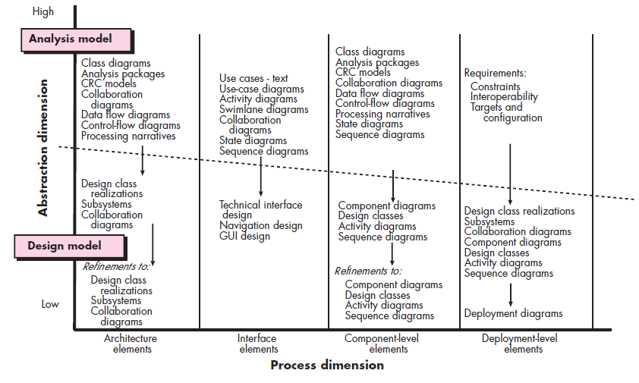
Design Models
Unit : III

Slide 82
Types of design elements:
Unit : III
1. Data design elements
The data design element produced a model of data that represent a high level of abstraction.
This model is then more refined into more implementation specific representation which is processed by the computer based system.
The structure of data is the most important part of the software design.

Slide 83
Unit : III
2. Architectural design elements
Provides us overall view of the system.
It is generally represented as a set of interconnected subsystem that are derived from analysis packages in the requirement model.
The architecture model is derived from following sources:
The information about the application domain to built the software.
Requirement model elements like data flow diagram or analysis classes, relationship and collaboration between them.
The architectural style and pattern as per availability.

Slide 84
Unit : III
3. Interface design elements
Represents the information flow within it and out of the system.
They communicate between the components defined as part of architecture.
Following are the important elements of the interface design:
1. The user interface 2. The external interface to the other systems, networks etc. 3. The internal interface between various components.

Slide 85
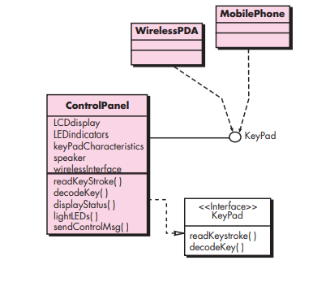
Unit : III
Interface

Slide 86

Unit : III
4. Component level diagram elements
The component level design for software is similar to the set of detailed specification of each room in a house.
Describes the internal details of the each software component.
The processing of data structure occurs in a component and an interface which allows all the component operations.
In a context of object-oriented software engineering, a component shown in a UML diagram.
The UML diagram is used to represent the processing logic.

Slide 87
Unit : III
5. Deployment level design elements:
Indicate how software functionality and subsystems will be allocated within the physical computing environment that will support the software.
For example, the elements of the SafeHome product are configured to operate within three primary computing environments—a home-based PC, the SafeHome control panel, and a server housed at CPI Corp. (providing Internet-based access to the system).

Slide 88
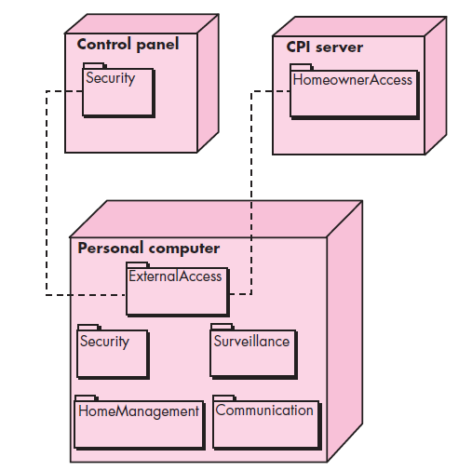
A UML deployment diagram
Unit : III

Slide 89
Code Review Analysis
Unit : III
Code review (sometimes referred to as peer review) is a software quality assurance activity in which one or several humans check a program mainly by viewing and reading parts of its source code, and they do so after implementation or as an interruption of implementation.
At least one of the humans must not be the code's author.
The humans performing the checking, excluding the author, are called "reviewers".

Slide 90
Unit : III
Although direct discovery of quality problems is often the main goal, code reviews are usually performed to reach a combination of goals :
Better code quality – improve internal code quality and maintainability (readability, uniformity, understandability, ...)
Finding defects – improve quality regarding external aspects, especially correctness, but also find performance problems, security vulnerabilities, injected malware, ...
Learning/Knowledge transfer – help in transferring knowledge about the codebase, solution approaches, expectations regarding quality, etc; both to the reviewers as well as to the author
Increase sense of mutual responsibility – increase a sense of collective code ownership and solidarity
Finding better solutions – generate ideas for new and better solutions and ideas that transcend the specific code at hand.
Complying to QA guidelines – Code reviews are mandatory in some contexts, e.g., air traffic software

Slide 91


